Slide 1
Employee SALARY Prediction
CAPSTONE PROJECT
Presented By:
Student Name- Pranav Ramchandra Raskar
College Name- Dy Patil University
Department – Computer Engineering

Slide 2
OUTLINE
Problem Statement (Should not include solution)
System Development Approach (Technology Used)
Algorithm & Deployment (Step by Step Procedure)
Result
Conclusion
Future Scope(Optonal)
References

Slide 3
Problem Statement
The goal of this project is to develop a machine learning model that predicts whether an employee earns more than 50K or less than or equal to 50K annually based on various demographic and work-related attributes. The model uses features such as age, education level, job role, working hours, and other personal details to classify salary categories. This prediction helps HR departments, recruitment agencies, and businesses understand salary trends and support data-driven hiring decisions. The project also includes a user-friendly Streamlit web application that allows both individual and batch predictions. By automating salary classification, the system enhances efficiency and reduces human bias in the evaluation process.

Slide 4
System Approach
System requires Python 3.9+, 8GB RAM, and Streamlit-compatible OS (Windows/Linux/macOS).
Data is collected, cleaned, and preprocessed using pandas and scikit-learn.
A classification model (e.g., Gradient Boosting) is trained to predict salary category (>50K or ≤50K).
The model is saved using joblib and integrated into a Streamlit web app.
Required libraries: pandas, numpy, scikit-learn, joblib, and streamlit

Slide 5
Algorithm & Deployment
Step-by-Step Procedure:
Problem Definition
Define the objective: Predict whether an employee earns >50K or ≤50K based on demographic and job-related data.
Data Collection
Download dataset (e.g., UCI Adult Income dataset) from a reliable source.
Data Preprocessing
Handle missing values, encode categorical features (e.g., gender, education).
Normalize or scale numerical data if needed.
Split data into training and testing sets.
Model Building
Choose and train classification models (e.g., Logistic Regression, Random Forest, Gradient Boosting).
Evaluate performance using accuracy, precision, recall, and F1-score.
Model Selection & Saving
Select the best-performing model.
Save the trained model using joblib or pickle.

Slide 6
Algorithm & Deployment
Web App Development
Use Streamlit to create an interactive user interface.
Collect user inputs and pass them to the model for prediction.
Display prediction results clearly.
Batch Prediction Feature
Add file uploader to handle CSV files for bulk predictions.
Process the uploaded file, make predictions, and allow CSV download.
Testing the Application
Test with various inputs and edge cases to ensure accuracy and robustness.
Final Deployment
Deploy locally using streamlit run app.py or on cloud platforms like Streamlit Cloud or Heroku.
Documentation & Report
Prepare report with problem statement, methodology, screenshots, and results.
Include system requirements, tools used, and conclusions.

Slide 7
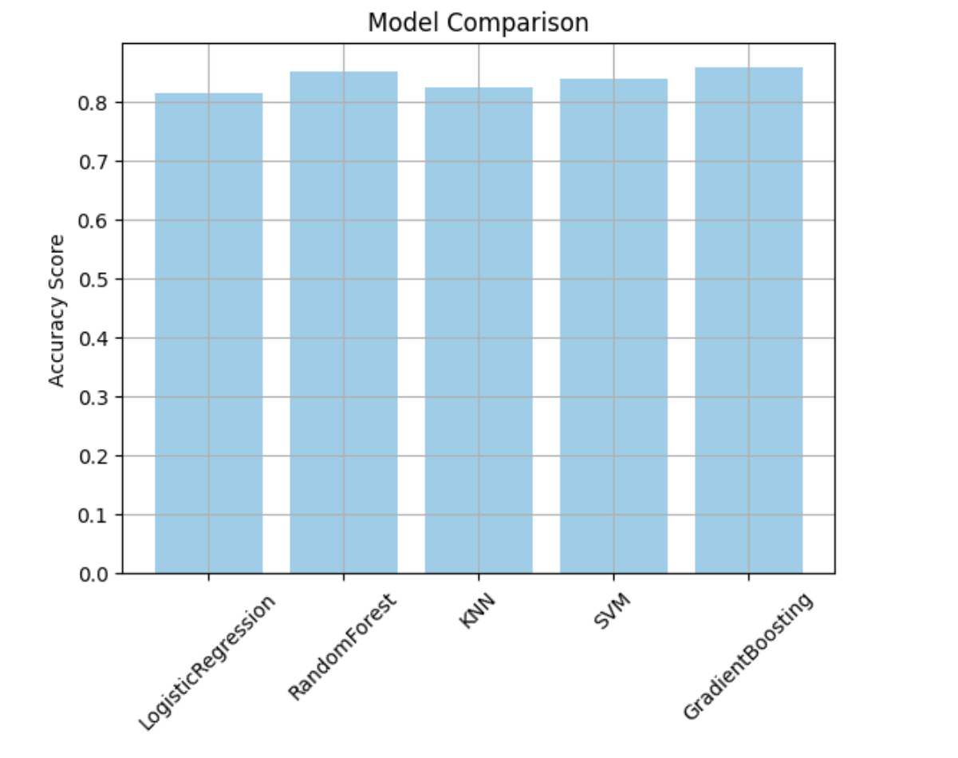
Result

Slide 8
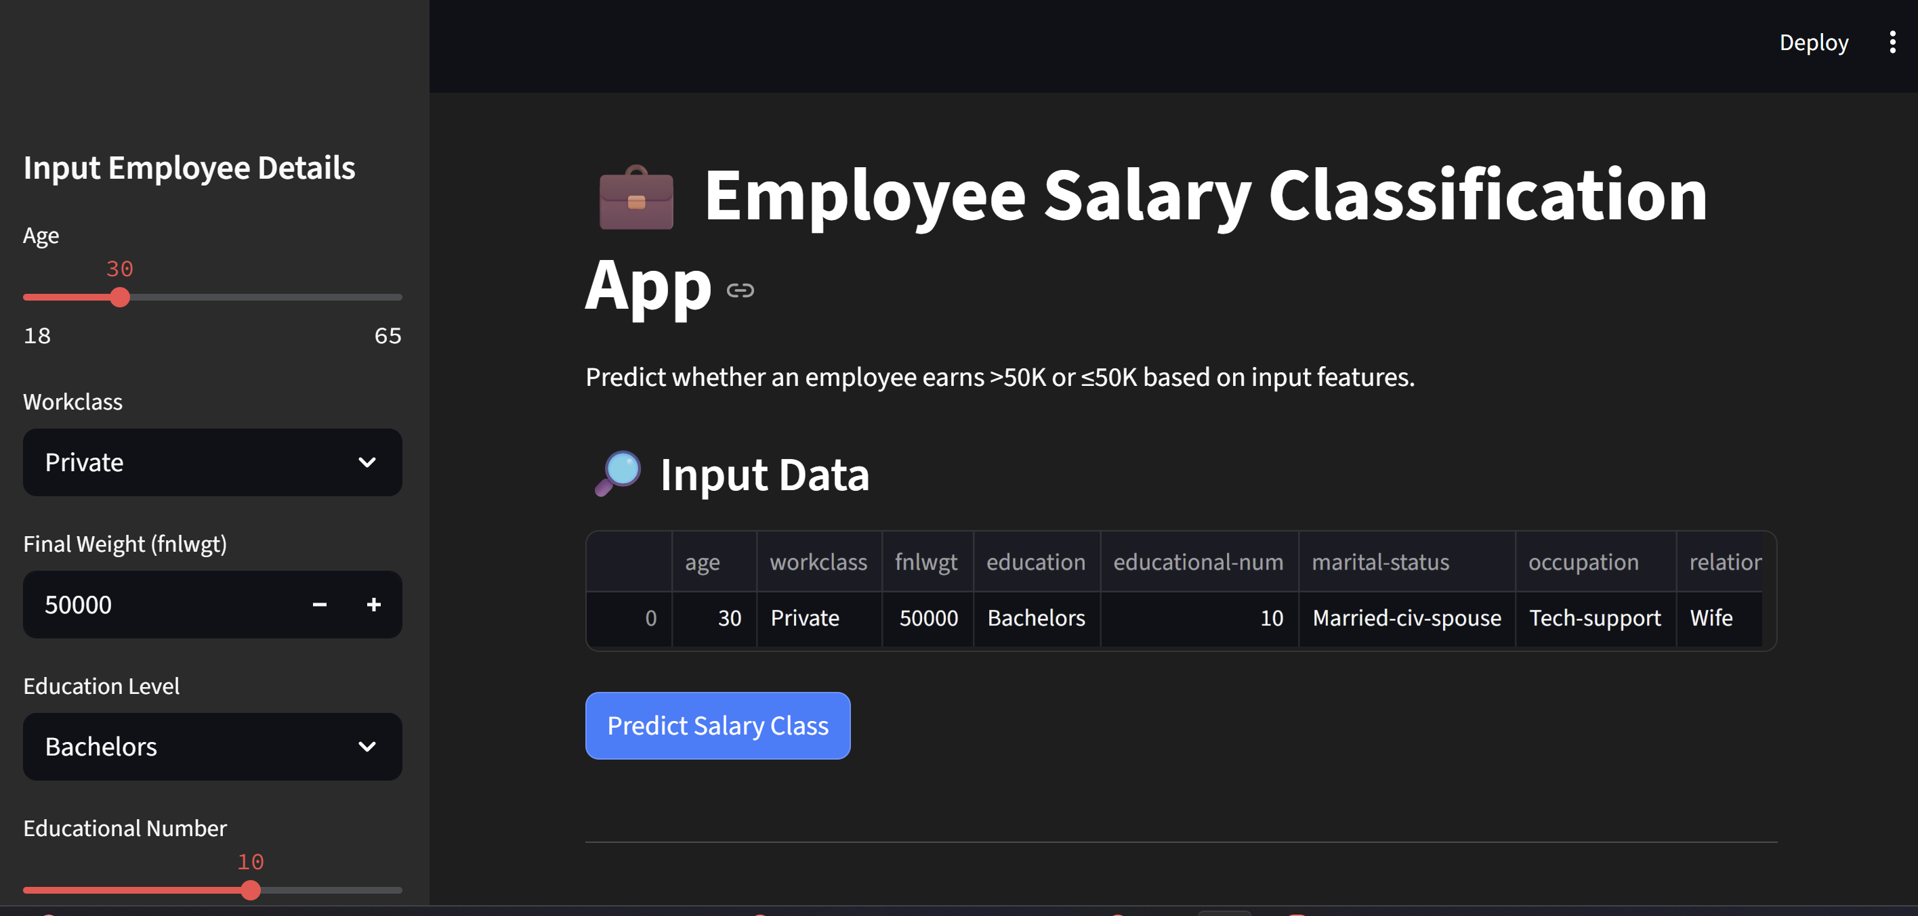
Result
GitHub :- ://github.com/PranavRaskar/Employees-Salary-Prediction.git

Slide 9
Conclusion
The model accurately predicts whether an employee earns >50K or ≤50K based on input features.
Gradient Boosting provided good performance and reliable classification results.
The Streamlit app made the system interactive and easy to use.
Faced challenges with feature mismatches and handling categorical variables.
Can be improved by adding visualizations, cloud deployment, and real-time data updates.

Slide 10
Future scope(Optional)
Convert the project into a full-featured job portal where job seekers can register, apply for jobs, and get salary predictions.
Add resume parsing and automated resume building features using NLP.
Allow employers to post jobs, view applicant dashboards, and get candidate salary predictions
Integrate Power BI or dashboards to track hiring trends and salary analytics.
Implement user login/authentication, profile history, and admin panel for job management.

Slide 11
References
UCI Machine Learning Repository – Adult Income Dataset Source of the dataset used for salary prediction. 📌 https://archive.ics.uci.edu/ml/datasets/adult
Scikit-learn Documentation Used for implementing machine learning models like Gradient Boosting, data preprocessing, and model evaluation. 📌 https://scikit-learn.org/stable/documentation.html
Pandas Official Documentation For handling data manipulation, cleaning, and analysis. 📌 https://pandas.pydata.org/docs/
Streamlit Documentation To build the interactive web application for salary prediction. 📌 https://docs.streamlit.io/

Slide 12
THANK YOU

